Slide 1

Data Introduction
Extension Climate Change (ECC) Data Jam
NMSU, December 8-9, 2016

Slide 2
What makes aWhere unique?
Solely Focused on
Agriculture
We are exclusively focused on agriculture outcomes. This defines our company and technology so we can uniquely understand how to create agricultural insight.
Complete Global
Information & Insight
We integrate a wide variety of data and processes to create complete and accurate ag-weather and agronomic insight both globally and at the field level.
Rapid, Flexible
Delivery via API
Our flexible and easy-to-integrate platform enables our customers to access our information and insight how, where and when they want it.

Slide 3
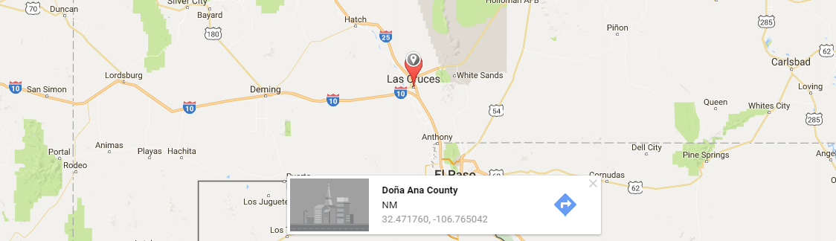
Data Overview
Location-based, point specific information
Daily Historical Observed Data
Forecast Data
Current Conditions
Long Term Norms
Agronomic Data

Slide 4
Daily Historical Observed Data
Min & Max Temperature
Precipitation
Solar Energy
Min & Max Relative Humidity
Average, Day’s Max, and Morning’s Max Wind Speed

Slide 5
Forecast Data
Min & Max Temperature
Chance of Precipitation
Precipitation Amount
Cloud Cover
Solar Energy
Average & Max Wind Speed
Average Relative Humidity
Dew Point
Min & Max Relative Humidity
Summary conditions

Slide 6
Current Conditions
Current Temperature
Recent Precipitation
Recent Solar Energy
Current Relative Humidity
Last reported wind speed

Slide 7
Long Term Norms
Mean, Min, & Max Temperature
Precipitation
Solar Energy
Min & Max Humidity
Mean & Max Wind
Agronomic Norms

Slide 8
Agronomic Data
Growing Degree Days/Units (GDD / GDU)
Potential Evapotranspiration (PET)
Ratio Precipitation to PET (P/PET)
Accumulated GDD
Accumulated Precipitation
Accumulated PET
Accumulated P/PET

Slide 9
Using aWhere’s Data
Temperature
Precipitation
GDD
PET

Slide 10
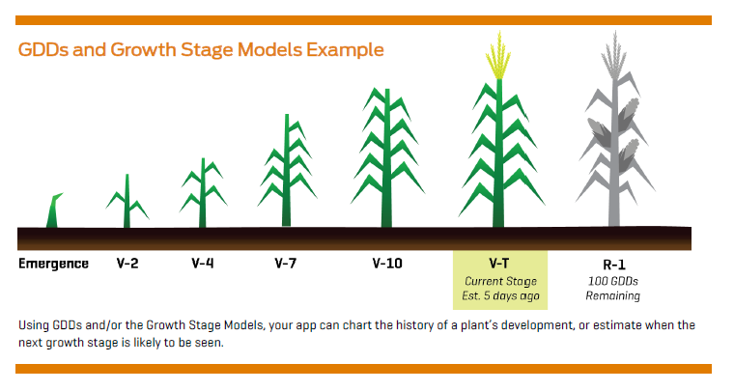
Standard Maize GDD Models

Slide 11
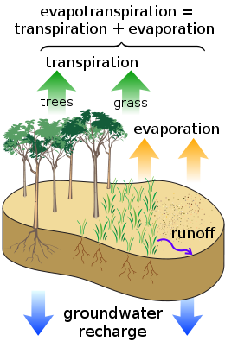
Potential Evapotranspiration (PET)

Slide 12
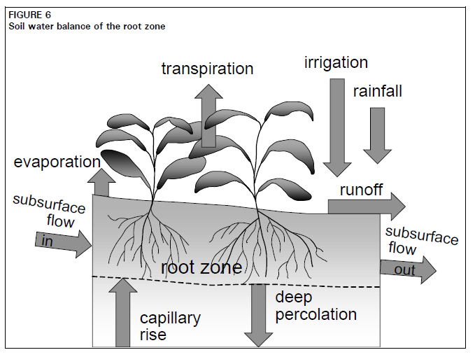
Precipitation / PET
Proxy for whether soil moisture amount changing over time
Doesn’t represent actual available water

Slide 13
Accessing aWhere’s Data

Slide 14
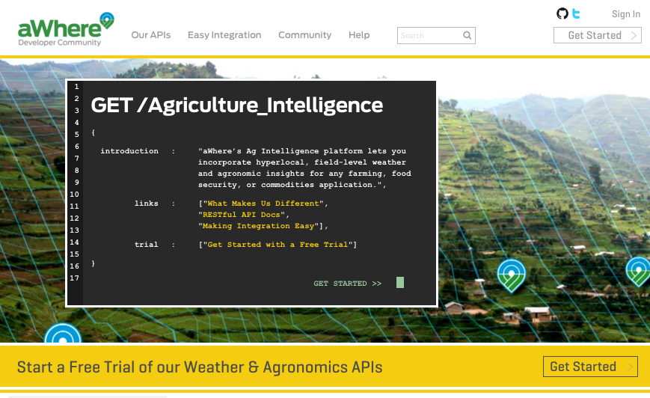
Developers - API
The aWhere Developer Community
Comprehensive Documentation
Tutorials & Best Practices
Sample Code
Support Community
Self-Service API credentials
Get started with a 30-day trial at developer.awhere.com

Slide 15
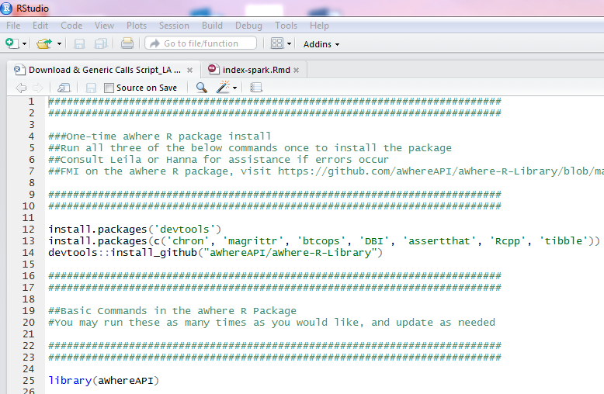
Statistical Package - R
The aWhere API R Package
Comprehensive Documentation
Pre-set functions
Requires API credentials
Get started by downloading at https://github.com/aWhereAPI/aWhere-R-Library or via the R script in the GitHub repository

Slide 16
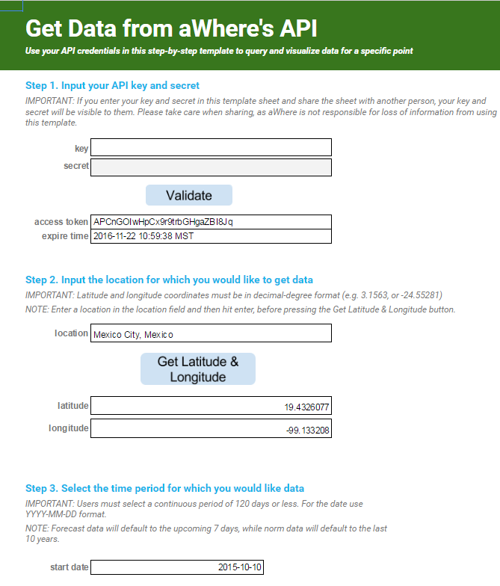
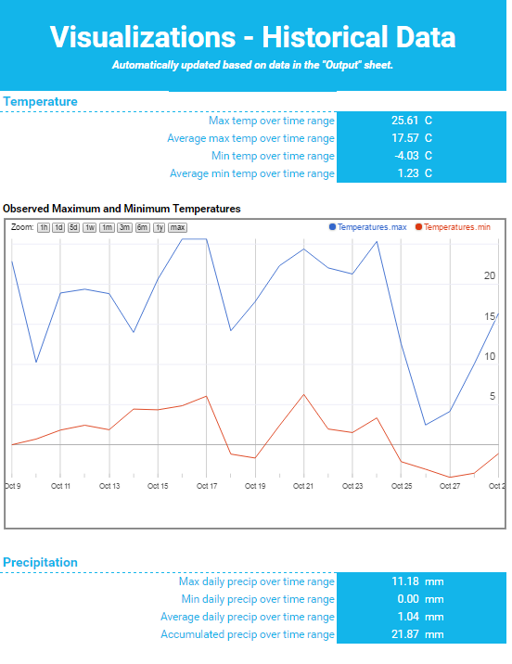
Google Sheets
The aWhere Google App
Download data to Google Sheets
Visualizations
Requires API credentials
Get started with link on GitHub repository

Slide 17


Denver, CO
awhere.com
303-279-9293
Leila Al-Hamodah
Client Engagement Manager
leilaalhamoodah@awhere.com
©2016 aWhere, Inc. Customer logos copyrighted by their respective owners. Some images licensed under Creative Commons courtesy NOAA, Ladd Observatory, Stephen Bowler
Notes:
Appendices

